Slide 1




DistrictswiseCR_AEdataf_24-25
https://www.linkedin.com/in/varsha-kotagiri-971583270?utm_source=share&utm_campaign=share_via&utm_content=profile&utm_medium=android_app
varshakotagiri06@gmail.com
DistrictswiseCR_AEdataf_24-25.csv

Slide 2
Introduction:
DistrictswiseCR_AEdataf_24-25
This dataset appears to contain information about case registrations and advice-enabled services across different states and districts in India for the year 2024-2025. It categorizes data based on different parameters such as gender, caste, and the number of Common Service Centers (CSCs).

Slide 3
Dataset Summary
Total Entries: 1,572 rows
Columns: 12, including categorical (e.g., "Category", "States/UT's", "Districts") and numerical fields (e.g., "No. of CSCs", "Female", "Male", "Total").
Size:1572 x 12
Key Fields:
Category: Type of data (e.g., "Case Registered").
States/UT's & Districts: Geographical information.
No. of CSCs: Number of Common Service Centers.
Gender Distribution: "Female", "Male", "Total".
Caste Categories: "General", "OBC", "SC", "ST".

Slide 4
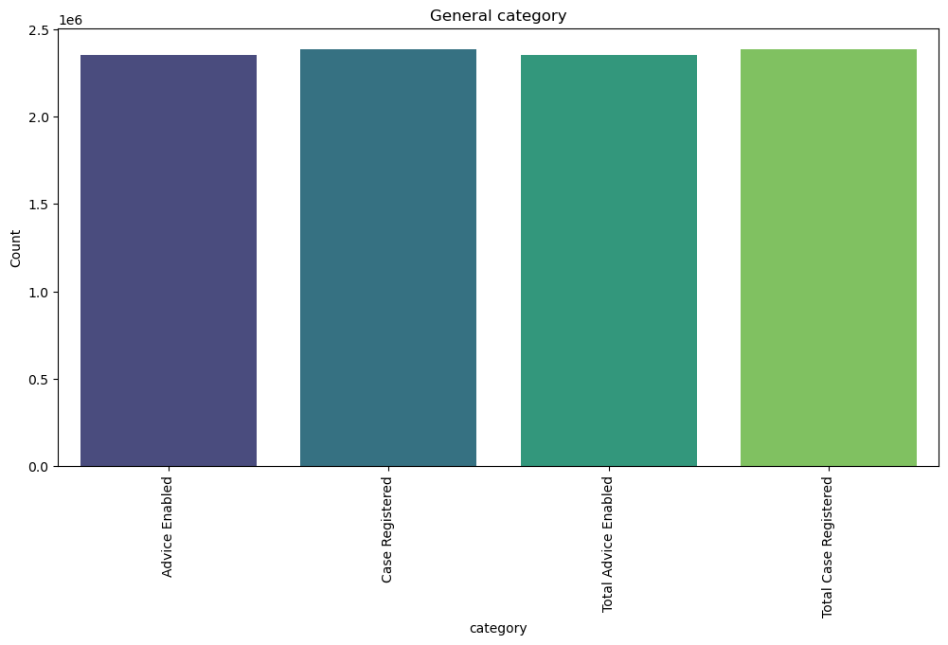
DATA VISUALIZATION
BARPLOT
It displays the distribution of total cases across different case categories, highlighting outliers. The boxplot helps in identifying districts or states where case numbers are significantly higher or lower than average, providing insight into regional disparities.

Slide 5
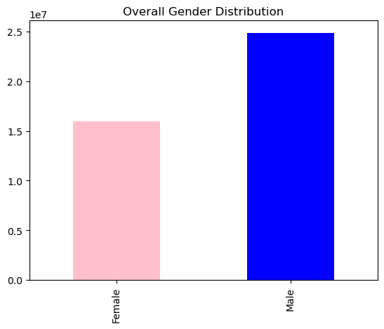
BARCHART
The Bar chat displays the overall gender distribution of Male and females
Here Male has highest population than Female

Slide 6
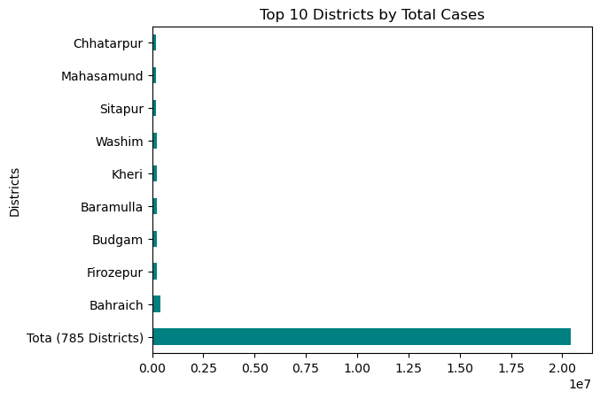
This visualization identifies the top 10 districts with the highest number of total legal cases. It helps highlight the regions experiencing the highest legal activity in terms of case registration.

Slide 7
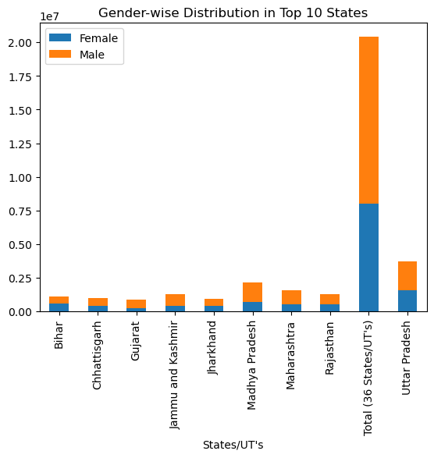
This visualization displays the gender-wise distribution of cases in the top 10 states with the highest total case counts. It helps analyze whether more legal cases are registered by males or females in high-case states.

Slide 8
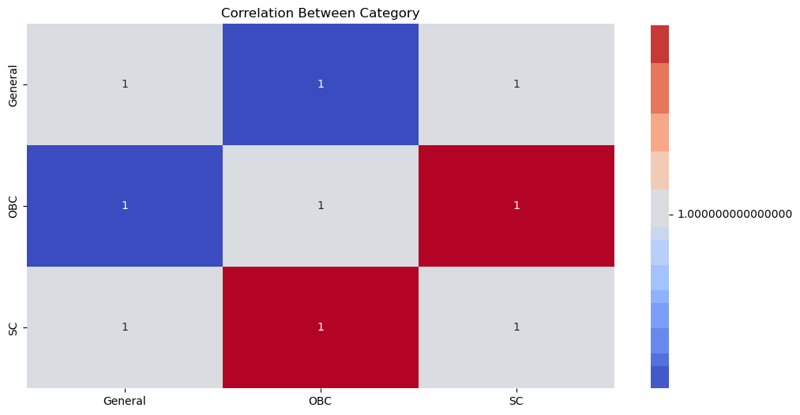
This heatmap visualizes the correlation between different case categories, helping identify relationships between them. A correlation matrix shows how strongly different categories are related numerically.

Slide 9
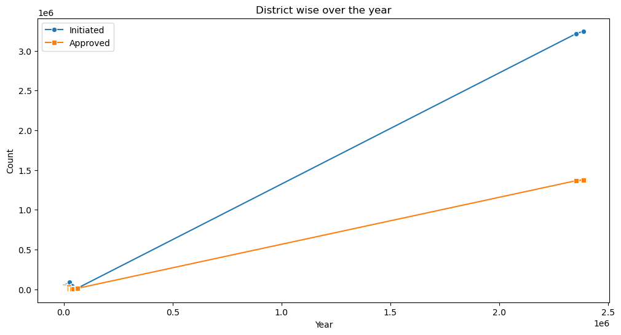
LINE CHART
This visualization highlights the total number of cases in each district over the years. It helps in understanding which districts have had higher case loads over time.

Slide 10
Observations from the Dataset:
"DistrictswiseCR_AEdataf_24-25.csv" The dataset differentiates between cases registered and advice-enabled services in each district. Some states have more advice-enabled cases than registered cases, indicating people are seeking legal advice before registering cases. The dataset categorizes cases into General, OBC, SC, and ST categories. SC & ST communities have a significant number of registered cases, highlighting legal challenges in these communities. Some states have higher case registration for OBC groups, indicating caste-related legal issues may vary by region. Certain states/districts have higher case registration rates, indicating high legal activity. Some regions show low case registration but high advice-enabled cases, suggesting people are seeking guidance rather than taking legal action. Differences in legal participation across states may be influenced by local policies, awareness campaigns, or socio-economic factors.

